Slide 1
Absolute Beginner’s Guide to Web Development!
Led by: Shonna Dorsey

Slide 2
Group Introductions
Name
Department
What you hope to get out of today’s session
Favorite hobby

Slide 3
Research Time
Break into groups of 2 or 3 (partner with someone you don’t know :))
Hint: Google and W3Schools.com are great resources!
For each of the following, please share a brief definition and its role in front end web development:
Group 1: HTML
Group 2: CSS
Group 3: JavaScript

Slide 4
HTML - hypertext markup language

Slide 5
What is HTML?
Hypertext Markup Language - Made up of tags, content and hyperlinks
Skeleton of the web - without HTML, we cannot see the content on your web pages!
Tag Examples: <strong> <em> <div>
Semantic Tags: <aside> <article> <section> <nav>
http://www.w3schools.com/tags/

Slide 6
HTML Page Breakdown - Document Kickoff and the <head> Section
<!DOCTYPE html>
<html>
<head>
<!-- info the page needs before it loads→
</head>
Includes <meta> tags, references to external content (CSS documents, JavaScript files), title for the page)

Slide 7
What’s the deal with <!DOCTYPE>
The <!DOCTYPE html> declaration is an instruction about which version of HTML the page is written in.
Currently, HTML is on version 5.x. Using <!DOCTYPE html> tells the browser that your page content is utilizing the latest version of HTML. Check w3.org for more information.

Slide 8
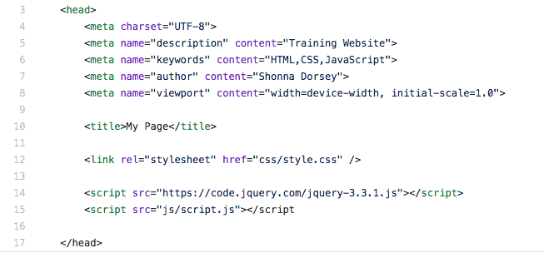
<head> (shoulders, knees, toes)...
The <head> section includes all of the information the page needs to load. An example of content within a <head> section follows:

Slide 9
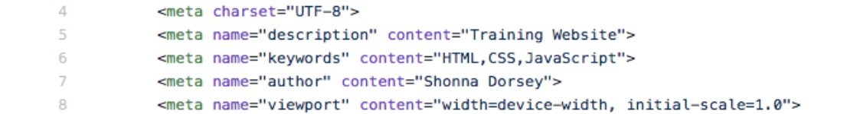
<meta> - data about data
<meta> tags are used for indexing, searching, etc. The more (relevant) information here, the better.

Slide 10
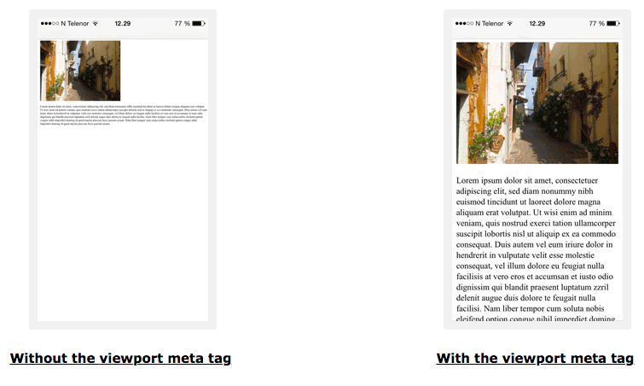
<meta> - data about data
One other important new attribute in the <meta> section is the ‘viewport’ attribute. Viewport is important in Responsive Web Design because it describes the page appearance based on the device size.
From w3schools, the example on the left is what a page looks like without viewport:

Slide 11

<title> - friendly name for ugly URLs
Every time you load a web page, you will see a ‘friendly name’ in the tab for the page. Here’s a screenshot from my current tabs (I know. It’s a lot :))
Each of those tabs appears with a ‘friendly name’ because of the title tag. Make it meaningful. Keep it short.

Slide 12
External Content - CSS References
CSS Stylesheets and JavaScript content can be entered directly into an HTML document.
This practice is ok for small projects. I recommend storing CSS and JS in external files - much easier to manage.
For CSS the format is:
<link rel=”stylesheet” href=”css/style.css” />
rel = relationship
href= hyperlink reference
/> = self closing tag.

Slide 13
External Content - JavaScript References
CSS Stylesheets and JavaScript content can be entered directly into an HTML document.
This practice is ok for small projects. I recommend storing CSS and JS in external files - much easier to manage.
For JS, the format is:
<!--library reference-->
<script src="https://code.jquery.com/jquery-3.3.1.js"></script>
<!--custom file-->
<script src=”js/script.js”></script>
IMPORTANT: Any library references must appear above the custom file

Slide 14
Let’s review in Github
Visit the following page: github.com
Click the sign in button:
Username: mooweb
Password: Pass@word123!
Once you are signed in, go to the following link:
tiny.cc/oct18-files
Click on your name
Click on index.html to view the <head> section

Slide 15
<body> section - where your content appears
Think about it like this:
<head>: info the page needs to load (brain of the page - behind the scenes)
<body>: visible content on the page (visible attributes of a person - hair, clothes, shoes, etc.)

Slide 16
<body> content - images, text, links...oh my!
The <body> section is made up of tags, attributes and content. A couple of examples follow:
Bold Text
Before bold <strong>bold text</strong> after bold
All of the content between the opening and closing <strong> tags will be bold in your browser
Linked Text
<a href =”http://google.com”>Best Search Engine!</a>
a = anchor, href=hyperlink reference, Best Search Engine = visible text, </a> = closing tag

Slide 17
<body> - images, text, links, lists...oh my
Images
Format: <img src=”image link” alt=”helper text for broken links/accessibility purposes” />
Example: <img src=”img/picture.jpg” alt=”Beach Photo” />
img = image tag
src =link to image file
alt = text that appears if the image doesn’t show up. Can also be used by screen readers for accessibility purposes.

Slide 18
<body> - images, text, links, lists...oh my
Text
You can use <p> tags to add text to a page and line breaks <br/> to add a single line of text between content. Examples:
<p>Here is some text. A little more text. Just a little more text.
<br/>
Adding one more line of content below the first line and closing out the paragraph </p>
Comments
Helpful notes which do not appear on a live web page, are called comments. Comment notation follows:
<!--here is a hidden comment--> This text (outside of the <!--comment-->), will appear on the page!

Slide 19
<body> - images, text, links, lists...oh my
Lists
There are two list types:
<ul> Unordered lists (bulleted lists)
<ol> Ordered lists (numbered lists)
Unordered List Example Ordered List Example
<ul> <ol>
<li>Bread</li> <li>Heat Skillet</li>
<li>Cheese</li> <li>Cook Grilled Cheese</li>
</ul> </ol>

Slide 20
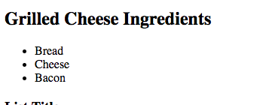
<body> - images, text, links, lists...oh my
Headings
Default heading sizes are <h1> - largest through <h6> - smallest. These tags are used to highlight important summary data within your HTML documents.
Example Input: Example Output:
<h2>Grilled Cheese Ingredients</h2>
<ul>
<li>Bread</li>
<li>Cheese</li>
<li>Bacon</li>
</ul>

Slide 21
Let’s review in Github
Once you are signed in, go to the following link:
tiny.cc/oct18-files
Click on your name
Click on index.html to view the <body> section
Let’s update the text, images and links

Slide 22
CSS - Cascading Style Sheets

Slide 23
Cascading Style Sheets - Pretty up the html
A Cascading Style Sheet (CSS) is used to add fonts, color, spacing, responsive design components, animations, etc., to html documents
CSS format follows:
Format Example
selector { p {
property : value; color: red;
} font-size: 2em; /*an em = 16px. Used for responsive sizing*/
}

Slide 24
Customizing a single element/group of elements
In HTML, use ID and class attributes to customize CSS content. A couple of examples follow:
Example (Bold and Gold Text)
HTML: <strong><p id=”gold”>Gold text.</p></strong> Text without formatting.
CSS: p { color: gold; }
Output: Gold text. Text without formatting.

Slide 25
Let’s review in Github
Once you are signed in, go to the following link:
tiny.cc/oct18-files
Click on your name
Click on the css folder, then style.css to view the custom CSS file:
Let’s update the font color, font size, background color, and image corners of elements in the index.html document

Slide 26
jQuery - write less. do more.

Slide 27
jQuery - Write Less. Do More.
JavaScript is a powerful and flexible scripting language, but can be intimidating for new developers. jQuery is an excellent entry point into interactive front-end web development.
The tagline for jQuery is ‘Write less. Do more.’
In this section of the deck, we are going to walk through setting up a jQuery document and customizing a couple of simple functions.

Slide 28
jQuery Setup - index.html and script.js
In our index.html file, you will notice a reference to a jQuery library hosted by jquery.com through a Content Delivery Network or CDN.
The library reference must appear before the custom file. Think about it like checking out a book from the library

Slide 29
jQuery Methods, Functions, etc.
jQuery methods, functions, etc., can be activated upon page load or after the user interacts with your page in a predefined way.
Example: Display hidden images when the page loads:
$(‘img’).fadeIn(slow);
Example: Hide images when a user clicks a button:
$(‘button’).click(function(){
$(‘img’).fadeOut(fast);
});

Slide 30
Let’s review in Github
Once you are signed in, go to the following link:
tiny.cc/oct18-files
Click on your name
Click on the js folder, then script.js to view the custom JS file:
Let’s make it so all images on the page disappear when we click the button
Let’s hide the background image on the page (<body>) when the page loads

Slide 31
Project Time!
Go to the following link to view documentation for our lab:
tiny.cc/oct18-files

Slide 32
Thank you!!

